Slide 1
Planning for College Costs
Lori Sloan
Ohio Northern University
Notes:
Introductions
Disclaimer—Not a presentation for ONU.
Find out how many parents are sending their first child to college

Slide 2
Overview
Free Application for Federal Student Aid (FAFSA)
Expected Family Contribution (EFC)
Cost of Attendance (COA)
Financial Need
Types of Financial Aid
Special Circumstances
Notes:
Topics for the night

Slide 3
Financial Aid
Funds that are provided to students and families to help pay for post-secondary educational expenses

Slide 4
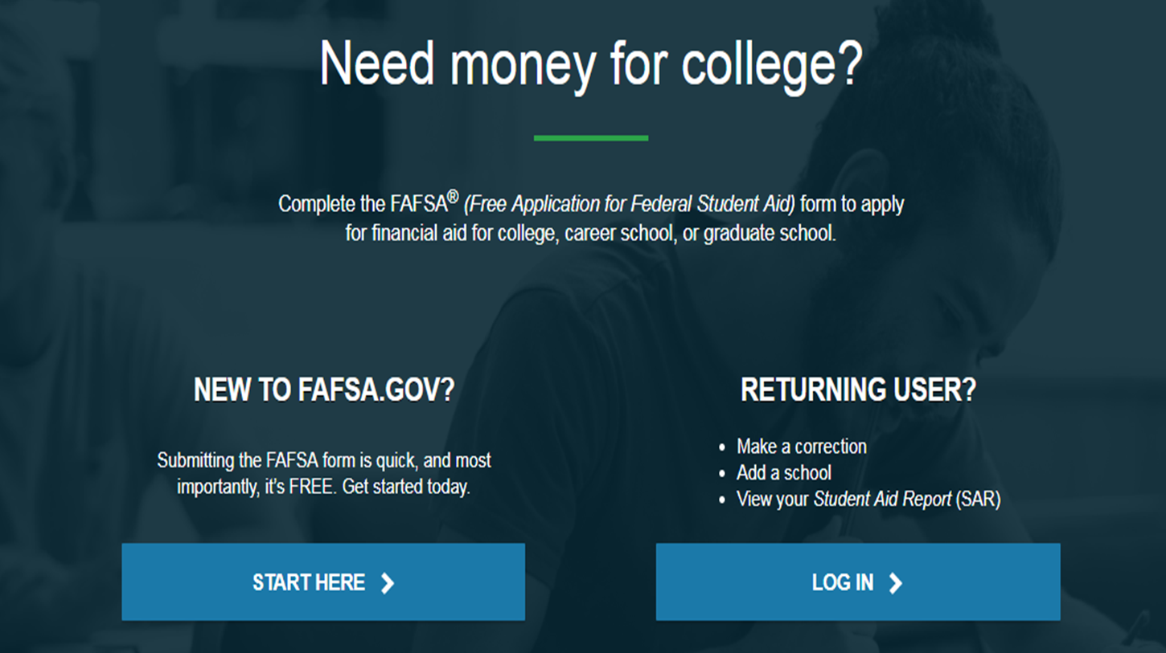
Free Application for Federal Student Aid (FAFSA)
Form that collects demographic and financial information about the student and family
Complete FAFSA online at www.FAFSA.gov
Available after October 1
Uses prior year tax information (2018)
Some colleges/universities have a filing deadline
A renewal application must be filed each year in order to continue receiving Federal Aid.
Notes:
Collects: SSN, Citizenship Status, Drug Convictions, Selective Service Registration, High School Completion
Asks: Dependency status questions. If all responses are “no”, student is a dependent student. If one question is answered “yes”, student is an independent student. Financial Aid Office may ask for documentation.
Financial Information: Tax, income, and other financial information, dislocated worker status, assets
Additional Information: College/school codes and housing plans

Slide 5
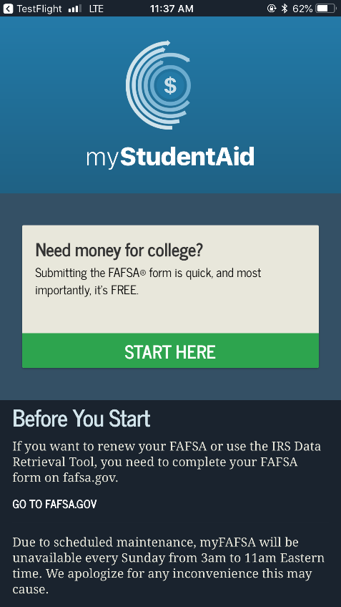
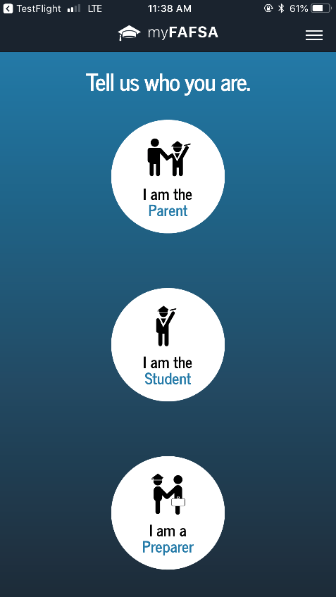
myStudentAid Mobile App
Mobile ability to begin, complete, save, and submit the FAFSA

Slide 6
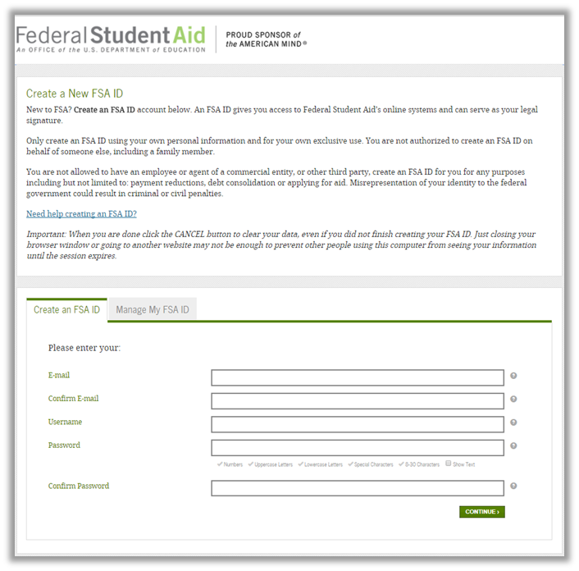
Federal Student Aid ID
Apply for FSA ID online at www.fsaid.ed.gov
Serves as login and signature on FAFSA
Both student and parent need to create own FSA ID
Use different email addresses!
FSA ID used throughout aid process and in subsequent years
Notes:
FSA ID required to log into studentloans.gov which allows student to complete entrance counseling and sign an MPN which is required to receive Federal Loans. Similarly, allows parents to log in to apply for Parent PLUS Loan.
Good idea to apply for FSA ID early so that the Social Security Administration can verify user.
Make sure that student create his/her own and parent(s) create his/her own with unique e-mail addresses. Cannot be same e-mail used for another FSA ID account. Needs to be an e-mail address that is accessible to you.

Slide 7
IRS Data Retrieval Tool
While completing FAFSA, applicant can submit real-time request to IRS for tax data
IRS will authenticate taxpayer’s identity
Can then choose to transfer data into FAFSA
Data transferred will not be displayed to FAFSA filer

Slide 8
IRS Data Retrieval Tool Continued
Available for use in October when you file the FAFSA, as long as 2018 Federal taxes are complete
Participation is voluntary
Reduces documents requested by the financial aid office
Cannot use IRS Data Retrieval Tool if:
Filed an amended tax return
No SSN was entered
Student or parent is married filing separately

Slide 9
Frequent FAFSA Errors
Social Security Numbers
Divorced/widowed/remarried parental information
Income earned by parent/stepparent
Untaxed income
U.S. income taxes paid
Household size
Number of household members in college
Real estate and investment net worth
Notes:
Talk about whose information gets reported when parents are divorced, divorced and remarried, etc.
Talk about parents being in college
Talk about 529 College Savings Plans (parental asset if student is dependent)

Slide 10
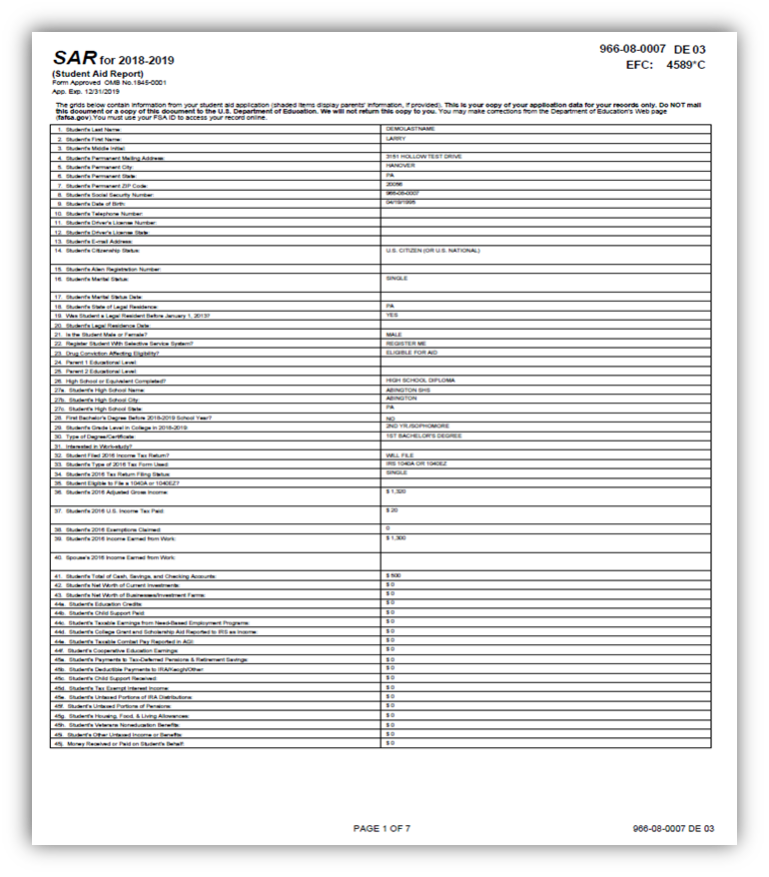
FAFSA Processing Results
A Student Aid Report (SAR) will be mailed or e-mailed to student
Record will be sent to colleges listed on the FAFSA approximately one week after the FAFSA is submitted
Colleges may request additional information once they receive the results
Corrections can be made on www.fafsa.gov, on paper SAR, or by submitting documentation to the financial aid office
Notes:
When you receive a copy of the SAR, make sure that you review the report for accuracy.
If you use estimated information when completing the FAFSA for the first time, be sure to update the information once actual figures are available

Slide 11
FAFSA and EFC
Information provided on the FAFSA is used to calculate the EFC
Amount that a family can reasonably be expected to contribute as determined by the Federal Government
EFC is the same at all institutions
Two components
Parent contribution
Student contribution
Colleges/universities use the EFC to award financial aid

Slide 12
Special Circumstances
Cannot report special circumstances on the FAFSA
Contact financial aid office for assistance
Examples:
Change in employment status
Medical expenses not covered by insurance
Change in parent marital status
Unusual dependent care expenses
Student cannot obtain parental information

Slide 13
Cost of Attendance (COA)
Direct Costs
Tuition, Fees, Room & Board
Indirect Costs
Books & Supplies, Transportation, Personal Expenses
Varies based on institution

Slide 14
Financial Need
Cost of Attendance (COA) – Expected Family Contribution (EFC) = Financial Need
Notes:
Explain chart

Slide 15
Types of Financial Aid
Scholarships
Gift aid
From College/University and outside sources
Grants
Gift aid
From Federal/State Government and/or College/University
Loans
Self-help aid
Federal, Private, and/or College/University
Student Employment
Self-help aid
Federal Work Study/Campus employment
Notes:
Explain free money versus money that needs repaid versus money that you can earn

Slide 16
Scholarships
Money that does not have to be repaid
Awarded based on:
Academics: GPA and ACT/SAT Scores
Athletics
Talent/Skill/Unique characteristic
Numerous sources:
High School Guidance Office
Local Organizations/Foundations/Clubs
Churches
Online websites/searches

Slide 17
Grants
Money that does not have to be repaid
Typically awarded based on financial need
Federal:
Federal Pell Grant
Federal Supplemental Educational Opportunity Grant (SEOG)
Teacher Education Assistance for College and Higher Education (TEACH) Grant
State:
Ohio College Opportunity Grant (OCOG)

Slide 18
Grants
Grant | 2019-2020 Award Amount
Federal Pell Grant | Up to $6,195 for an EFC of 5576 or less
Federal Supplemental Educational Opportunity Grant (SEOG) | Up to $4,000; varies based on the institution; awarded to students with exceptional financial need
TEACH Grant | Up to $4,000
Ohio College Opportunity Grant (OCOG) | Up to $2,000 for public and $3,500 for private and non-profit institutions with an EFC of 2190 or less and a maximum household income of $96,000
Notes:
A FAFSA is required for these grants.
TEACH- Financial need is not a requirement; for undergraduate students enrolled in a college/university that has chosen to participate in the program; meet certain academic achievement requirements, which typically include scoring above the 75th percent in ACT/SAT and having a cumulative GPA of at least a 3.25; must complete TEACH Grant Counseling and sign a TEACH Grant Agreement to Serve.
OCOG- For Ohio residents (12 months) attending an Ohio college/university; FAFSA deadline is October 1

Slide 19
Loans
Money that students and/or parents can borrow to help pay for college
Repayment generally begins after graduation
Borrow only what is necessary

Slide 20
Loans
Loan | Interest Rate 2019-2020 | Fees | Grace Period | Need-Based
Direct Subsidized Loan | 4.53% fixed* | 1.062% | Six months | Yes
Direct Unsubsidized Loan | 4.53% fixed | 1.062% | Six months | No
Parent PLUS Loan | 7.08% fixed | 4.248% | None | No
Private/Alternative Loan | Varies | Varies | Varies | No
*No interest accrues during period of enrollment
Notes:
A FAFSA is required for Direct Subsidized and Unsubsidized Loans as well as the Parent PLUS Loan.
A student is responsible for Direct Subsidized and Unsubsidized Loans. A Parent PLUS Loan is the responsibility of the borrower, which can be a parent or step-parent of a dependent, undergraduate student. A Private Loan is the responsibility of the student, but over 90% of all applications require a credit-worthy cosigner.
There is no grace period for Parent PLUS Loans, but payments can be deferred during the period of the student’s enrollment. If payments are not deferred, they will begin 60 days after the last disbursement for the loan period.
Private loan interest rates vary and depend on whether the loan is a fixed or variable rate loan. Interest rates can be as low as 2 or 3% on a variable rate loan and as low as 5 or 6% on a fixed rate loan. Some lenders advertise $0 fees and typically have a six or nine month grace period.
Standard repayment for all loans is 10 years, but extended repayment plans may be available for up to 20 or 25 years.

Slide 21
Dependent Direct Loan Borrowing Limits
Grade Level | Amount
Freshman | $5,500; up to $3,500 subsidized
Sophomore | $6,500; up to $4,500 subsidized
Junior/Senior | $7,500; up to $5,500 subsidized
Aggregate Limit | $31,000; up to $23,000 subsidized
Notes:
Amounts for independent students starts out at $9,500 and go up to $12,500 based on grade level. The aggregate limit is $57,500 and up to $23,000 may be subsidized.
The annual limit for a Federal Perkins Loan is $5,500.
Parent PLUS Loans and Private Loan amounts vary. Generally speaking, you can borrow up to the student’s cost of attendance less all other aid.

Slide 22
Federal Work Study
Allows a student to earn money to help pay for educational expenses
Earn a paycheck or receive non-monetary compensation such as room and board
Employment can be on or off campus
Typically pay minimum wage
FAFSA is required

Slide 23
Next Steps
Colleges create award packages for families once FAFSA is received
Award packages become available in winter/spring
Follow up with the financial aid office at the college you decide to attend
Complete any additional required paperwork
Follow deadlines to maximize scholarship, grant, and award eligibility

Slide 24
More Info: studentaid.ed.gov
Notes:
Can also contact Financial Aid Office

Slide 25
Thank You For Coming!
Any Questions?
My Contact Information:
419-772-2700
L-Sloan@onu.edu

